Slide 1

MEDIA & THE PUBLIC
Week 2: Foundation
Ryan Wang
ryanyang@psu.edu

Slide 2
WHAT IS POLITICAL COMMUNICATION ABOUT?

Slide 3
The intellectual origins of political communication
Voting studies
Media influences on group membership and group identity
Symbolic politics
Rhetoric, image, language and semiotics
Psychology
Persuasion and propaganda; information processing; cognition
Institutional approach
Structure, organization, and regulation of media
Signaling approach
Collective action: new technologies have changed both the costs and the processes of political organization
Media economics
Market segmentation based on consumers’ political preferences

Slide 4
A BRIEF HISTORY OF MEDIA (EFFECT)

Slide 5
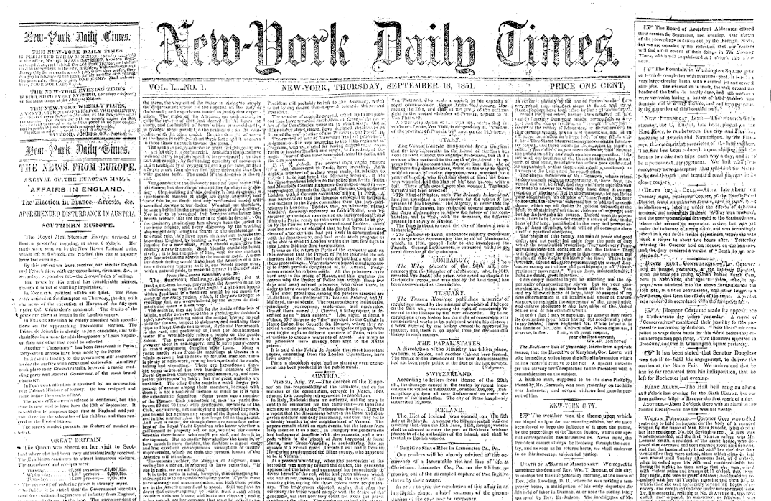
The evolution of media

Slide 6
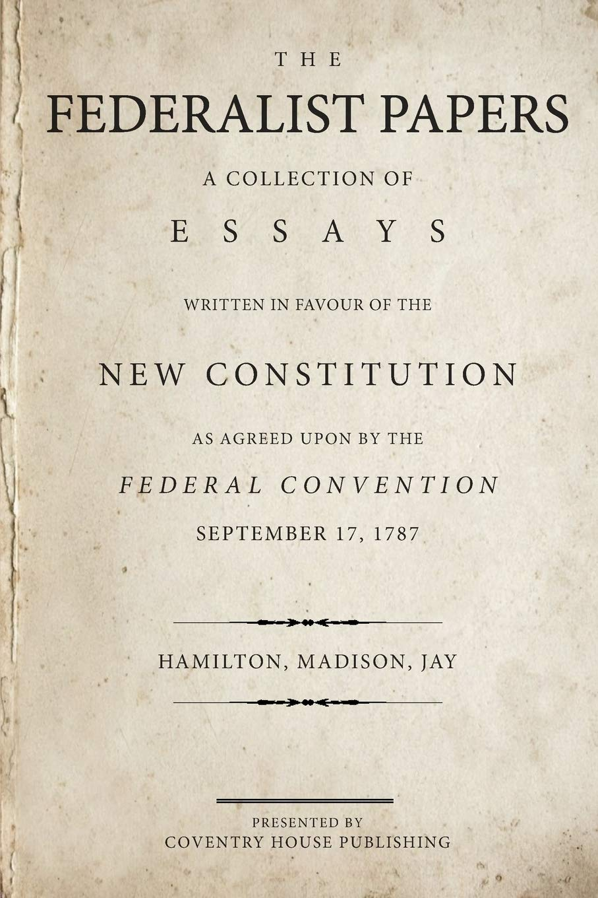
The evolution of media

Slide 7
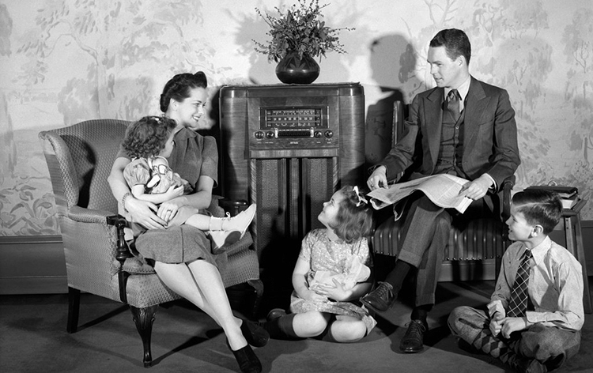
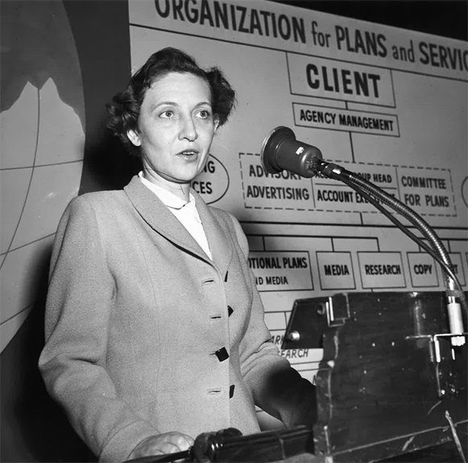
The evolution of media

Slide 8
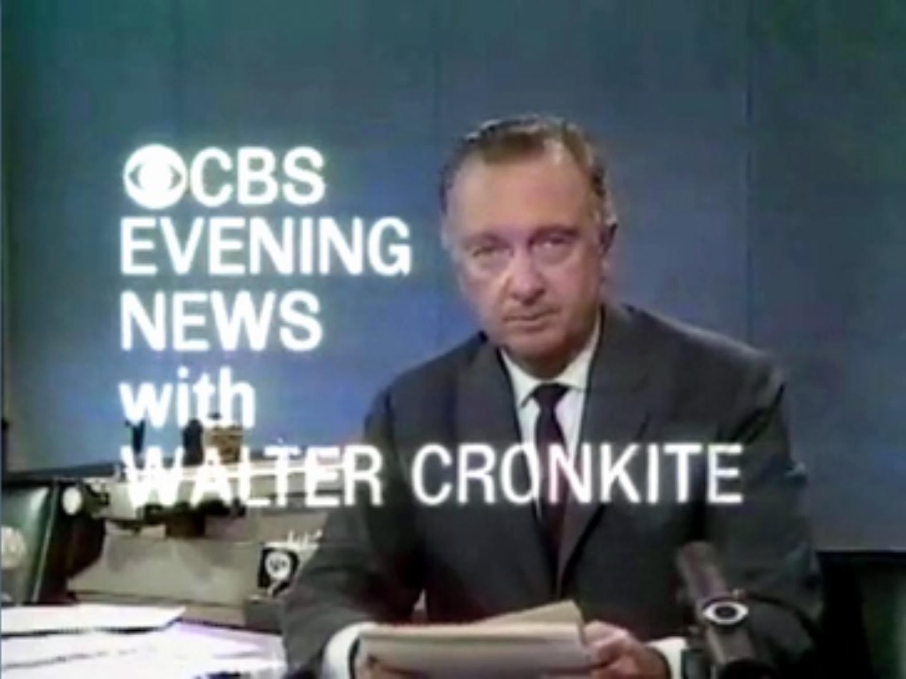
The evolution of media

Slide 9
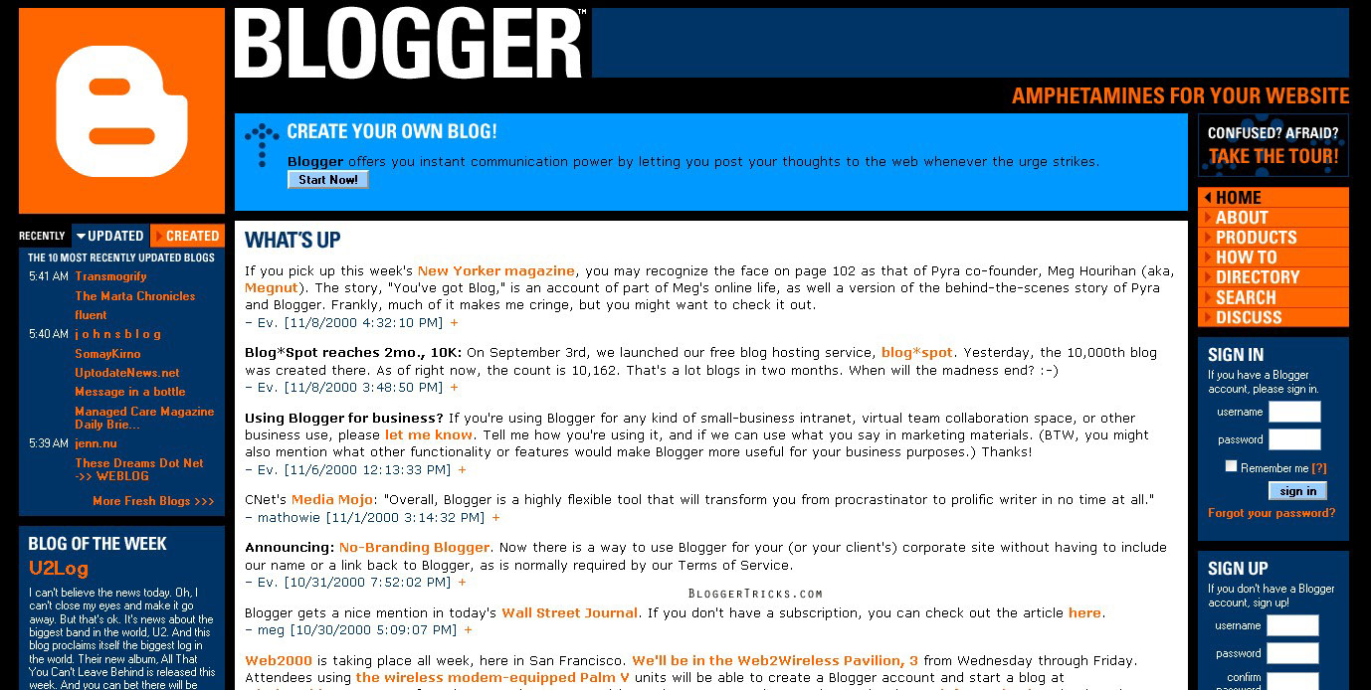

The evolution of media

Slide 10
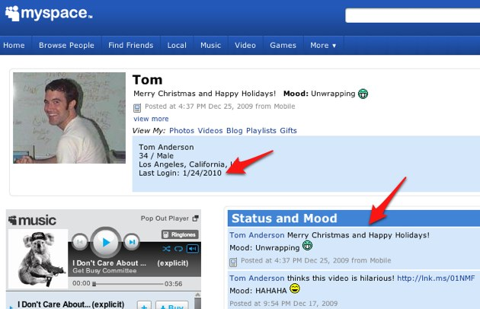

The evolution of media

Slide 11
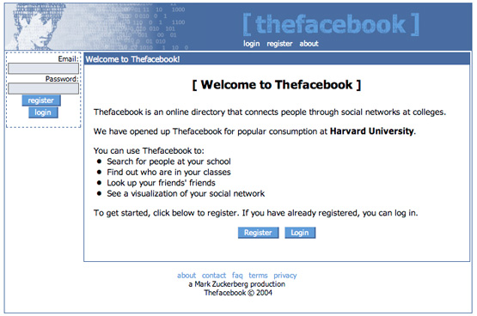
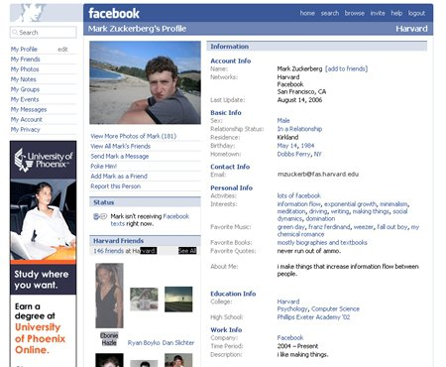
The evolution of media

Slide 12
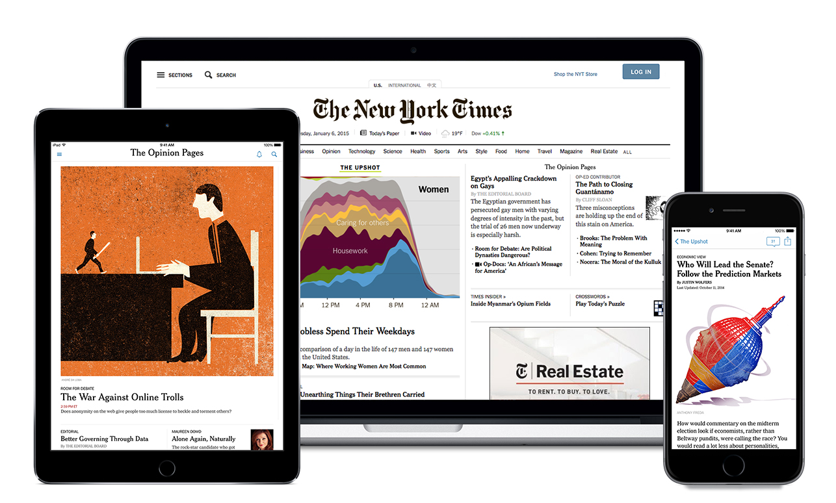
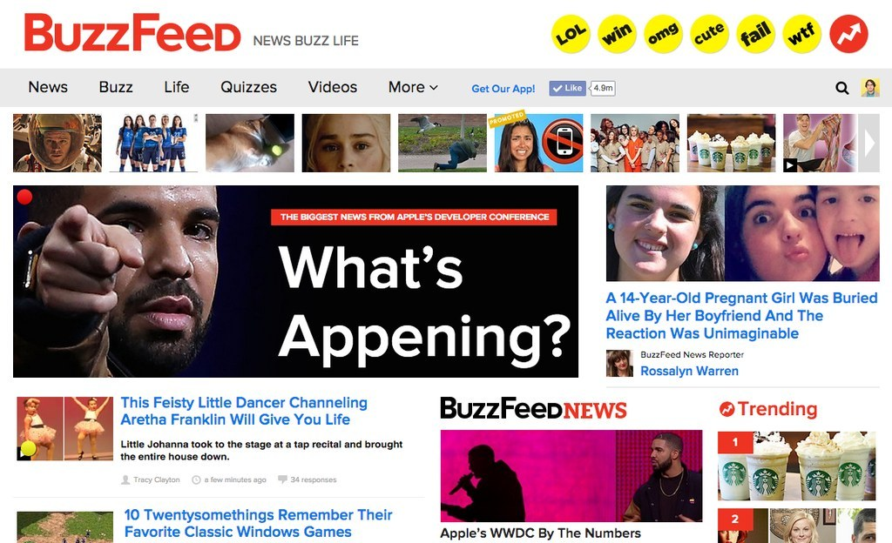
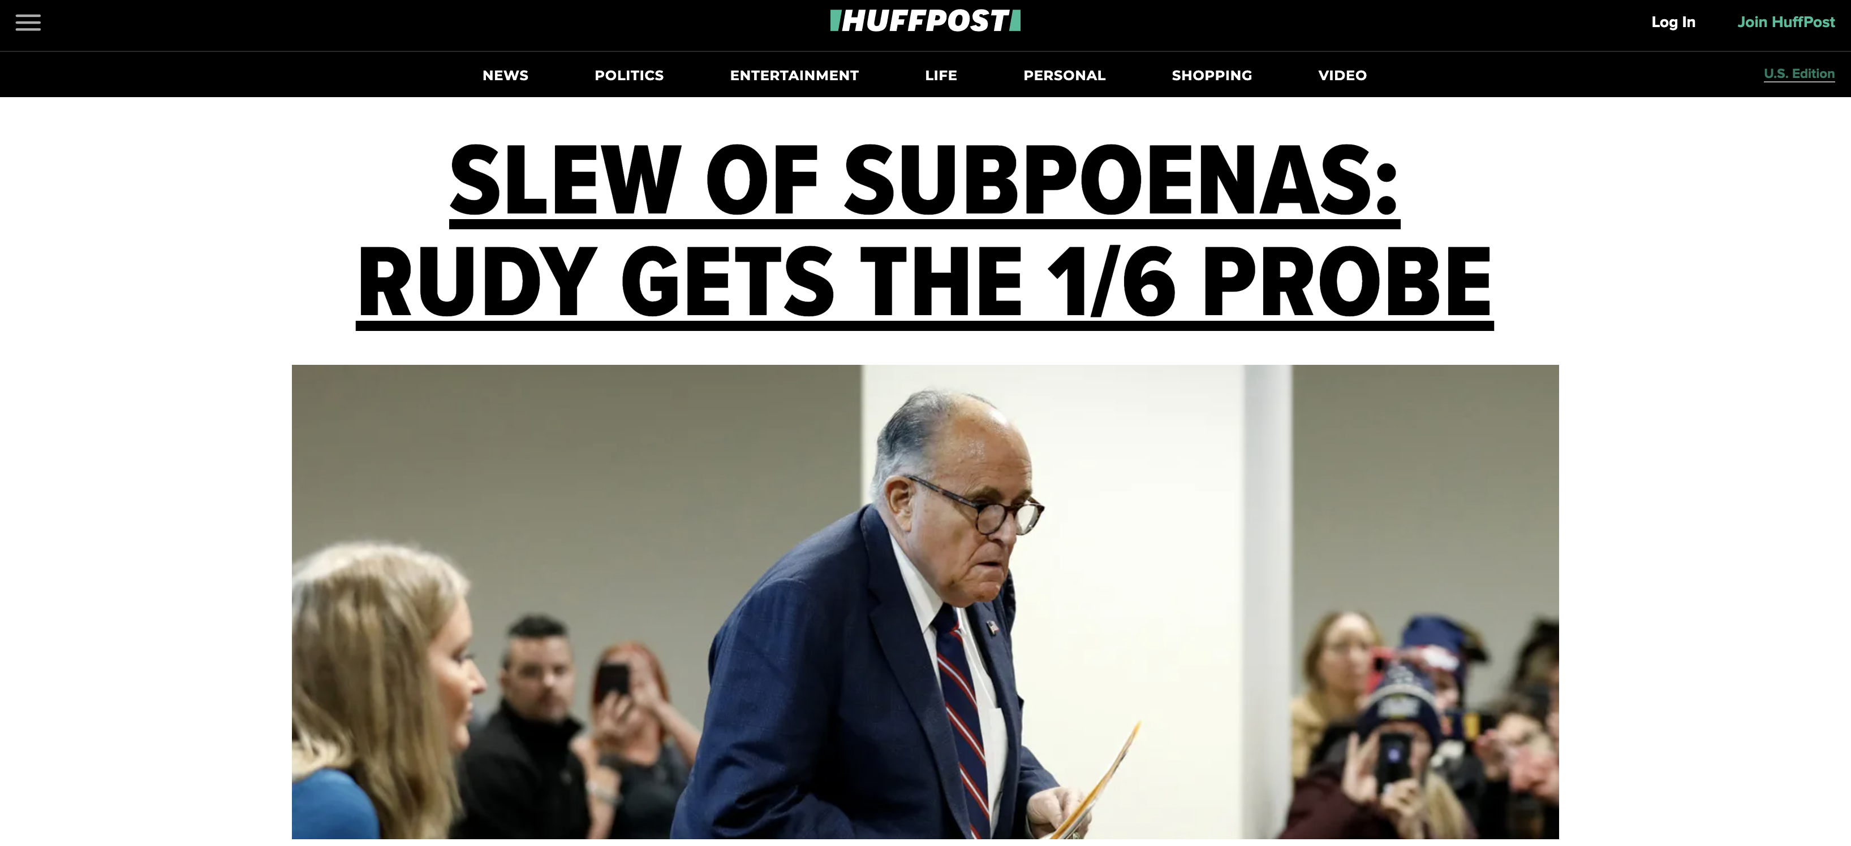
The evolution of media

Slide 13
Strong/Powerful media effect
McQuail’s four phrases model (2005)
WWI - 1930s
1930s – 1960s
Selective exposure
Magic Bullet
Hypodermic Needle
1960s – 1970s
Two-step flow
1970s -
Spiral of silence
Cultivation
Social constructivism
Framing
Agenda setting
Limited media effect
Revisit of strong media effect
Negotiated/transactional media effect

Slide 14
Strong/powerful media effects era
Time: World War I to 1930s
Assumption: the media are not that influential
Media: omnipotent power to shape opinion and belief, to change habits and audience behavior
Audience: defenseless against the stimuli of media

Slide 15
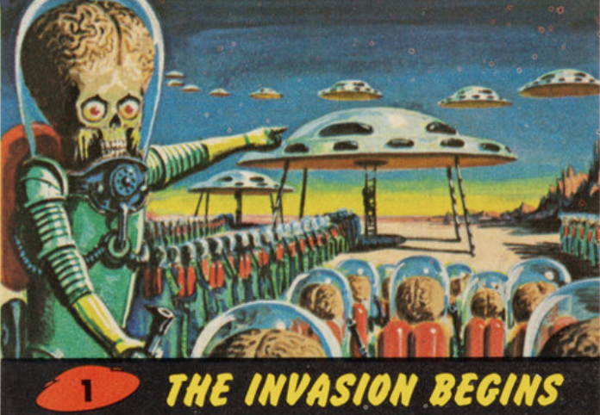
The invasion from Mars?

Slide 16
Limited media effects era
Time: 1930s to 1960s
Assumption: the effects of the media on the population would be exceedingly strong
Characteristics:
Selective exposure and selective perception
Opinion leader and two-step flow
Social group formation

Slide 17
The renaissance of strong media effect
Time: 1960s to 1970s
Assumption: The media could overcome some audiences’ selectivity processes in a highly media-saturated environment (i.e., TV)
Characteristics:
Profound long-term effects/consequences
Availability and application of survey data and content analysis; more sophisticated methods like time-series analysis.
Examples: agenda-setting, framing, knowledge gap, cultivation.

Slide 18
The negotiated/transactional effects era
Time: 1970s
Assumption: media outlet construct meanings about various aspects of the social world and present these in a systematic way to audiences; while audiences interact with the symbolic constructions offered by the media
Characteristics:
The audience is active and participatory in a process of meaning construction that involves a continuous negotiation between the audience's worldview and the meanings offered in the mass media.
Qualitative and ethnographic research methods

Slide 19
WHAT HAVE CHANGED?

Slide 20
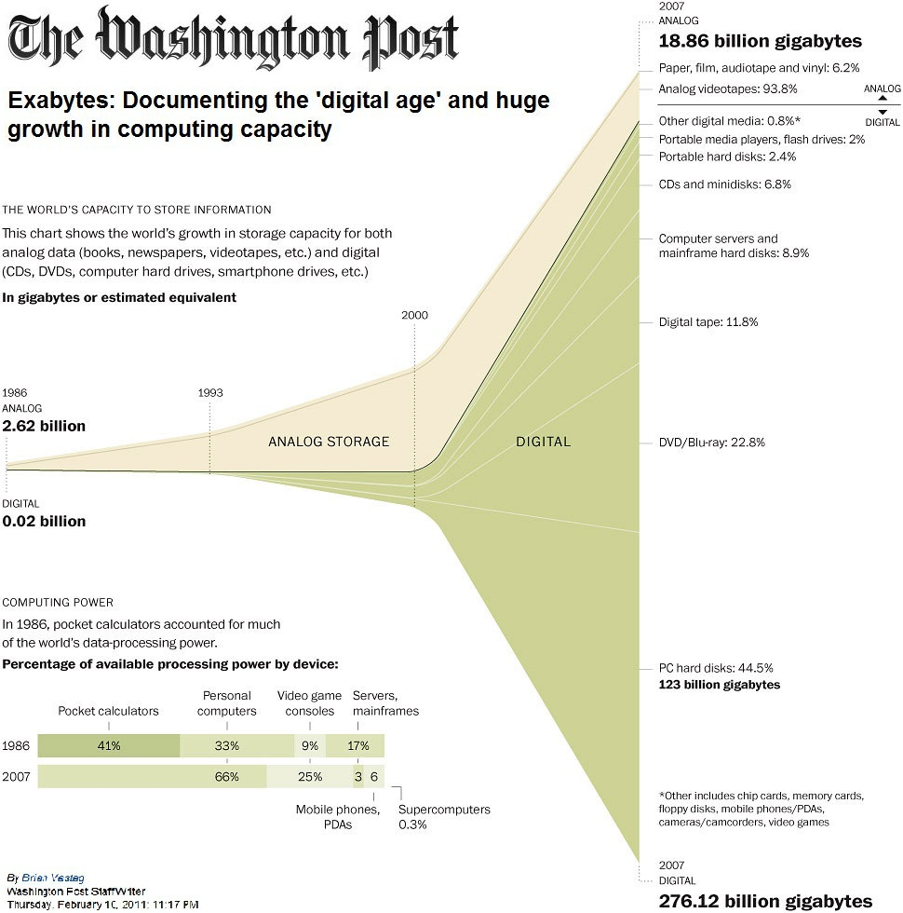
A new era of media and politics?
Source: Hilbert & López (2012)
Notes:
300 hours of video are uploaded to YouTube every minute!
Almost 5 billion videos are watched on Youtube every single day.
Pinkfong’s “Baby Shark” stands as one of the most-watched videos of all time, currently passing 10 billion plays.

Slide 21
A new era of media and politics?
The composition of audiences
The delivery of information
The experience of politics itself

Slide 22
A new era of media and politics?
The composition of audiences:
Less dense memberships in a group-based society networked through political parties, churches, unions, and service organizations
The fragmented audience in an era of selective exposure
The delivery of information
The increasing capacity of consumers to choose from a multitude of media channels (which also enable user-generated content)
The experience of politics/political information
The demise of the inadvertent audience

Slide 23
What have changed in media?
(traditional offline media vs. Internet/Social media)
Content production and distribution
Consumption

Slide 24
END OF MASS MEDIA?

